Slide 1
Setting up software for CE 597
CE 597: Data Science for Smart Cities
Rajat Verma
August 25, 2023

Slide 2
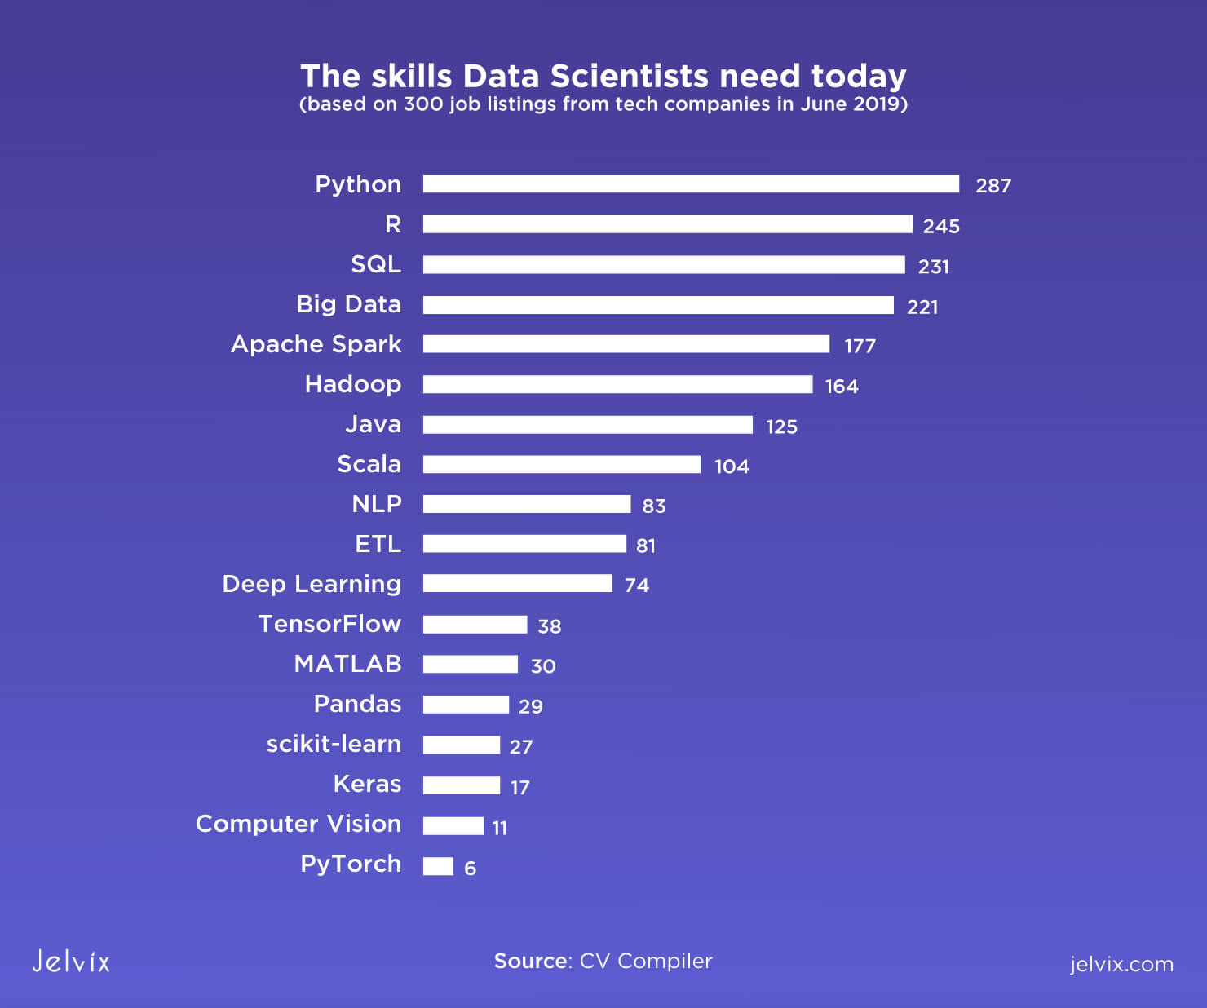
Intro to Python for data science
One of the most necessary skills for data science
Pros
Easy to learn
Good for scripting and notebook editing
Enormous developer base and libraries
Cons
Slow in its native form
High memory consumption

Slide 3

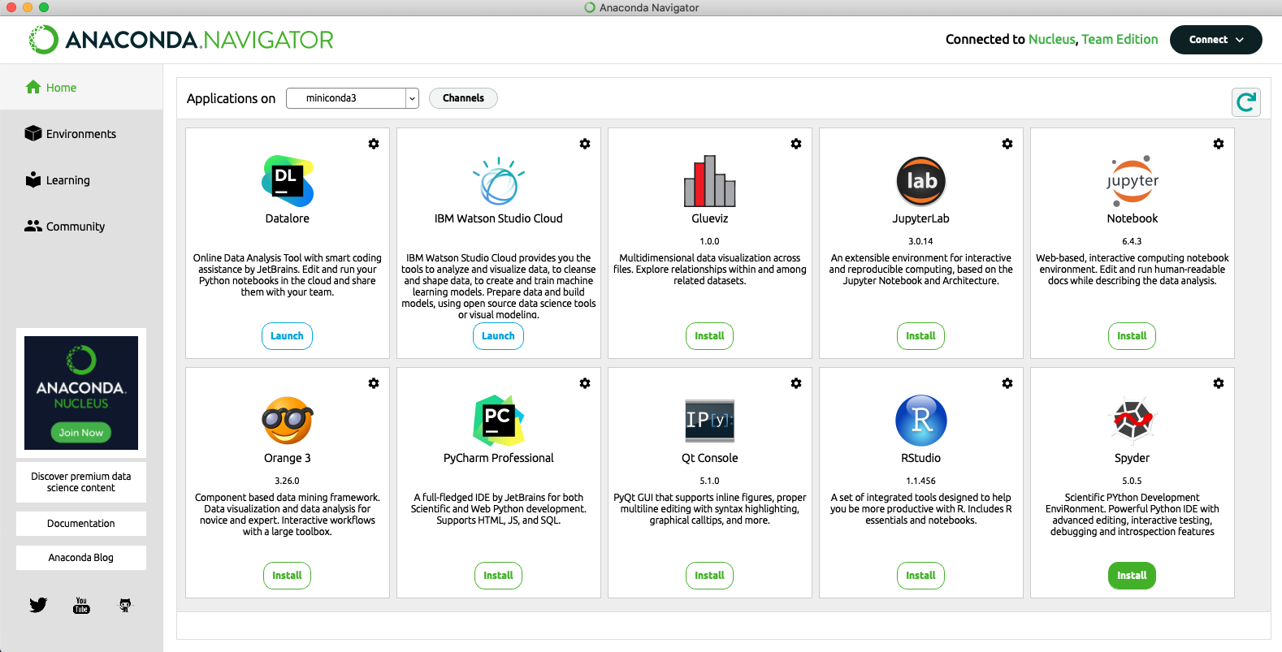
Anaconda
We will use this popular package manager for Python and R
Helps in separating “environments” for different purposes for different libraries/versions

Slide 4
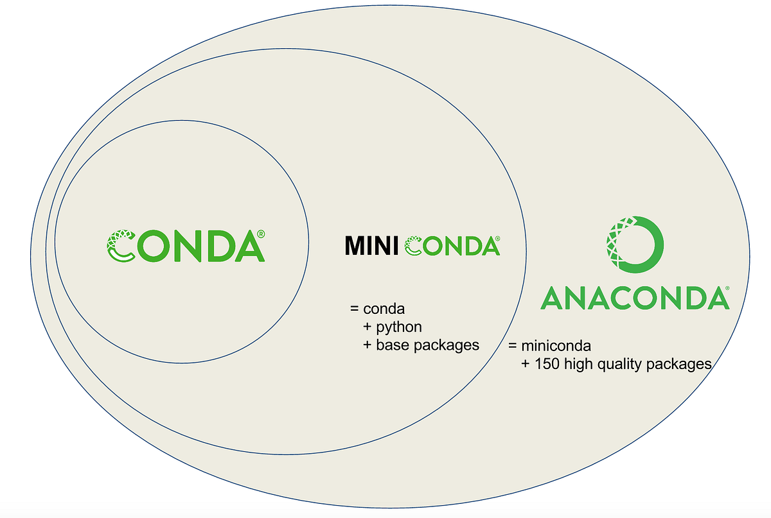
Installing Anaconda
Detailed installation instructions on https://docs.anaconda.com/free/anaconda/install
Note:
If you want a smaller package manager (e.g., if you have limited resources), you can try installing Miniconda

Slide 5
Jupyter Notebook/Lab
Jupyter = Julia + Python + R (3 popular data science languages)
To run “kernel” of a language by creating a local server
What are code notebooks?
Combination of code and rich text (markdown format)
Can run multiple languages in same notebook (esp. Bash)
Greatly useful for data exploration
Different from scripts which only include code (see this comparison)
Jupyter Notebook (traditional) and Jupyter Lab (new)
JavaScript-based programs that create a local server

Slide 6
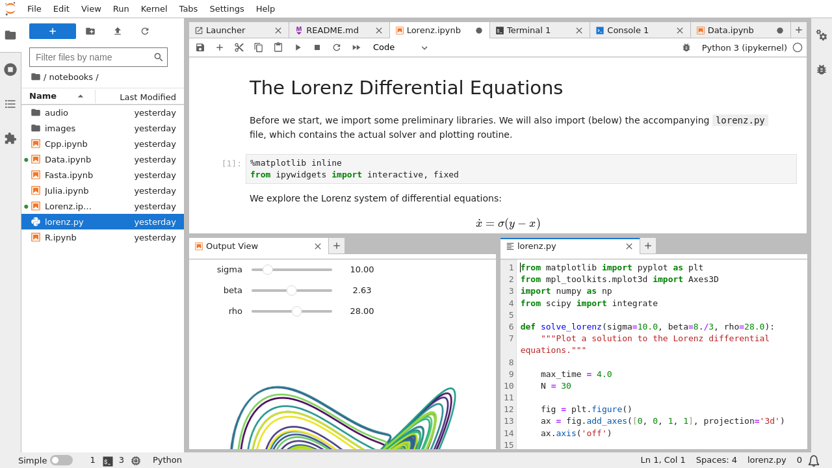
Jupyter Lab

Slide 7
Installing Jupyter Lab
We will use Jupyter Lab instead of Notebook
But Notebook is also acceptable
Instructions for installing Jupyter Lab (use the conda method): https://jupyterlab.readthedocs.io/en/stable/getting_started/installation.html
Running Lab (see instructions):
Go to your course/project folder of interest
Run jupyter lab

Slide 8
What’s next
If there’s any error in installation, please talk to me (verma99@purdue.edu)
We will start with creating our first notebook in class and starting with Python
If you are new to Python and/or programming, it is strongly recommended to learn the basics
Some useful resources:
Best online Python introductory classes
RealPython.com is a good starting point
Programming: Codecademy, GeeksForGeeks, TutorialsPoint

